Slide 1

Team Name : Team IntelliLearn
Team Leader Name : Shravani Jaydeepp Kolte
Problem Statement :Build an AI-powered solution that helps people learn faster, work smarter, or become more productive while building or understanding technology.

Slide 2

Brief about the Idea:
DYNLEARN is an AI-powered learning assistant designed to improve learning productivity for students and freshers by providing clarity on skill development. Many students invest time in learning without knowing whether their skills align with the requirements of a specific job role, leading to inefficient and unfocused learning.
DYNLEARN addresses this challenge by analyzing a student’s current skill set (through manual input or resume analysis) and comparing it with the skill requirements of a selected target job role. Using AI-driven analysis, the system identifies missing skills and prioritizes them based on relevance and importance.
By clearly highlighting what skills need to be learned first, DYNLEARN helps students learn smarter, avoid unnecessary effort, and follow a focused learning path that aligns with real-world job expectations.

Slide 3
Your solution should be able to explain the following:
How different is it from any of the other existing ideas?
Existing platform recommend courses not skill gaps
No prioritization of what to learn first
DYNLEARN focuses only on missing and critical skills
How will it be able to solve the problem?
Compares student skills with job role requirements
Clearly identifies missing skills
Provides learning priority instead of random suggestions
USP of the proposed solution
AI-driven skill gap analysis with priority-based learning direction

Slide 4
List of features offered by the solution
Core Features
Student skill input (manual / resume)
Target job role selection
AI-based skill comparison
Skill gap identification
Priority-based learning order
Simple and student-friendly interface
.

Slide 5
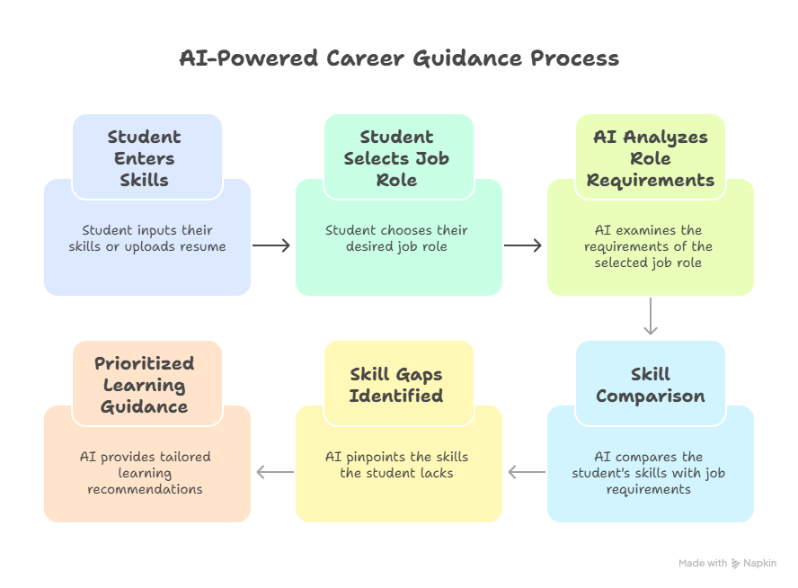
Process flow diagram or Use-case diagram

Slide 6
Architecture diagram of the proposed solution:
High-Level Architecture
Frontend: Student web interface
Backend: Skill processing logic
AI Layer: Skill comparison & prioritization engine
Database: Stores skill profiles and analysis results

Slide 7
Technologies to be used in the solution:
Frontend: Web UI (HTML, CSS, React)
Backend: Python / Node.js
AI: LLM-based skill analysis & recommendations
Database: Cloud-based database
Authentication: Basic login (optional)

Slide 8
Add as per the requirements for the hackathon:
Impact
Improves learning productivity
Reduces confusion and overload
Helps students learn with focus
Especially useful for Tier-2 / Tier-3 college students
Beneficiaries
College students
Freshers
Self-learners

Slide 9


